Slide 1
Wireless and Mobile Networks
Project
Bank Network Design Proposal
Samruddhi Chandrashekhar Naik
619

Slide 2
Overview
Bank Network Elements
Quality of Services (QoS)
Security
Management
Proposed Architecture
Network devices

Slide 3

Bank Network Elements
Inter/Intra Branch Communication
Inter Bank Communication
Self Service Solutions ( ATM/E-Teller )
Contact Center Solution
Data Center
Disaster Recovery
E-Banking/Mobile Banking Solutions
Work From Home / Remote Access Network Solutions

Slide 4
Quality of Service(QoS) considerations To ensure Guaranteed and Low Latency delivery
Priority queuing
Eliminate congestion
Random Early Detection
Weighted fair queuing
Low latency queuing
Support IPv6 Dual Stack
Traffic Shaping (TS), Traffic Policing (TP)
DSCP Marking, policing and shaping
IPv6 Packet classification & Marking, IPv6 Policing & Shaping, IPv6 Queuing

Slide 5
Security considerations
IPv4 IPv6 ACL entries
Hardware assisted NAT PAT
Layer 2 encryption protocol for Data Confidentiality and Integrity
Multiple Privilege Levels for managing & monitoring
Access control - RADIUS TACACS+
Controlled SNMP Access
DHCP DNS spoofing prevention
DoS/DDoS prevention

Slide 6
Layer 3 protocols
RIPv1, RIPv2, OSPFv2, v3, BGP
IS-IS routing protocols
Bi-Directional Forwarding detection for reducing the network convergence
Load Balancing Protocol using ECMP
MPLS Features
Traffic Engineering
Label Stack Encoding
Loop Prevention Mechanism

Slide 7
Firewall / Intrusion Prevention System
Providing firewall, application visibility, IPS functionality, Malware Protection and URL filtering
Hardware based, reliable, purpose-built security appliance with hardened OS supporting State full policy inspection technology
Dedicated Out of Band management port and HA port
Threat performance throughput
Concurrent sessions, connections per second, VLANs
Intrusion event data correlation, elimination of false positives and policy compliance
Multicast protocols like IGMP, PIM
Tuning IDS/IPS sensors
Appropriate inspections and protections for traffic sent over non-standard communications ports

Slide 8
Detecting and blocking IPv6 attacks
No limit in terms of handling logs per day
Support URL and DNS threat intelligence feeds, safe search
Detect and prevent malware, network probes/reconnaissance, VoIP attacks, buffer overflows, P2P attacks
Threat Grid Sandbox appliance
Anomaly detection techniques
Blocking of files by types, protocols and directions
Active/Active or Active/Passive Clustering

Slide 9
Management
SLA verification probes/alerts configurations
Real-time performance monitoring
Sessions, packets, bandwidth usage
Debug and Diagnostics through CLI
Error status
Dynamic ARP table
Trace-route, ping
Management and Reporting
Web-based GUI

Slide 10
Contact Center Solution
Helpdesk system
Centralized helpdesk environment for IT support
Omni-channel capabilities including support for inbound voice, outbound voice, chat, email, bot integration
Communication Platform
Call control Server or an IP PbX to manage IP telephony for the Bank
IP Phones must fallback to redundant server automatically and recover to primary server
Automatic Call Distribution (ACD)
Support skill based routing
Longest available agent, circular agent selection algorithms
Universal routing logic for all channels
Queuing of calls
Interactive Voice Response (IVR)
Hard Phones for Helpdesk Agents & Non-Agents
PSTN Integration for Helpdesk

Slide 11
Global Server Load Balancing
Virtualization
Complete fault isolation between virtual load balancer instances
Dynamic routing Protocols like BGP, OSPF
IPsec VPN load balancer
Load balance IPsec VPN tunnel
End-to-End SSL Encryption
To load balance traffic
Persistency
Modification
Link load balancing
Application performance monitoring
Application acceleration

Slide 12
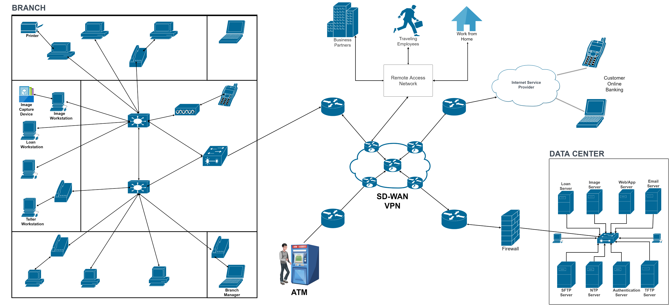
Bank Network Architecture

Slide 13
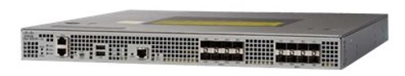
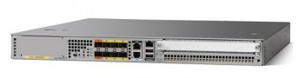
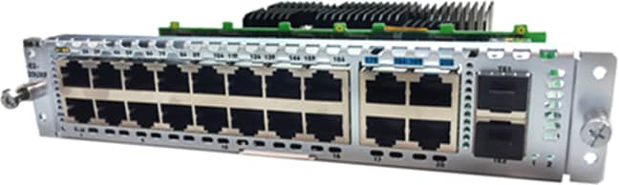

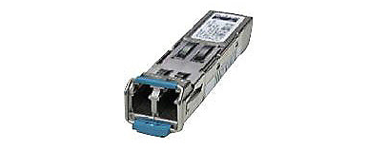
Network Devices
Device Type | Part Number |  | Specifications
VPN Routers | Cisco ASR1001-HX |  | https://www.cisco.com/c/en/us/products/routers/asr-1001-hx-router/index.html
SDWAN Routers | Cisco ASR1001-HX-DNA |  | Cisco ASR 1001-HX, 4x10GE+4x1GE, Dual PS with DNA Suport
Core Routers | ISR4451-X/K9 |  | https://www.cisco.com/c/en/us/support/routers/4451-x-integrated-services-router-isr/model.html#~tab-specs
Switch | Nexus N9K-C9364C-GX |  | https://www.cisco.com/c/en/us/products/collateral/switches/nexus-9000-series-switches/nexus-9300-gx-series-switches-ds.html
Transceivers | SFP-10G-SR-S= |  | https://www.cisco.com/c/en_in/products/collateral/interfaces-modules/transceiver-modules/data_sheet_c78-455693.html

Slide 14
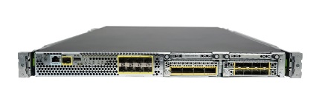
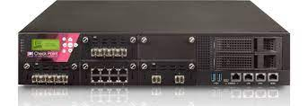
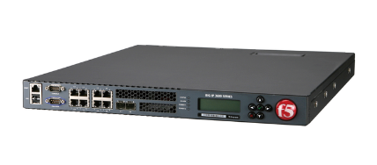
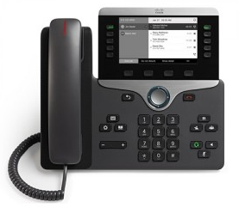
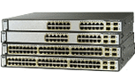
Network Devices
Device Type | Part Number |  | Specification
Firepower | FPR4K-NM-8X10G= |  | https://www.cisco.com/c/en/us/td/docs/security/firepower/4100/hw/guide/b_install_guide_4100/overview.html
Firewall | Checkpoint 23500 & 15600 Firewall |  | https://www.checkpoint.com/downloads/products/15600-security-gateway-datasheet.pdf
Load Balancer | F5 i5800 Load balancer |  | https://worldtechit.com/f5-products/f5-big-ip-i5600-i5800-hardware-datasheet/
IP Phone | CP-8841-K9= |  | https://www.cisco.com/c/en/us/products/collateral/collaboration-endpoints/unified-ip-phone-8800-series/datasheet-c78-731638.html
Firewall/IPS | CON-SNTP-FPR4110N |  | https://itprice.com/cisco/con-snt-fpr4110n.html

Slide 15
Thank You

